Slide 1
SECTIONS OF SOLIDS.
STUDY CAREFULLY
THE ILLUSTRATIONS GIVEN ON
NEXT SIX PAGES !

Slide 2
SECTIONING A SOLID.
An object ( here a solid ) is cut by
some imaginary cutting plane
to understand internal details of that object.
The action of cutting is called
SECTIONING a solid
&
The plane of cutting is called
SECTION PLANE.
Two cutting actions means section planes are recommended.
A) Section Plane perpendicular to Vp and inclined to Hp.
( This is a definition of an Aux. Inclined Plane i.e. A.I.P.)
NOTE:- This section plane appears
as a straight line in FV.
B) Section Plane perpendicular to Hp and inclined to Vp.
( This is a definition of an Aux. Vertical Plane i.e. A.V.P.)
NOTE:- This section plane appears
as a straight line in TV.
Remember:-
1. After launching a section plane
either in FV or TV, the part towards observer
is assumed to be removed.
2. As far as possible the smaller part is
assumed to be removed.
OBSERVER
ASSUME
UPPER PART
REMOVED
SECTON PLANE
IN FV.
(A)
(B)
ASSUME
LOWER PART
REMOVED
SECTON PLANE
IN TV.
OBSERVER

Slide 3
ILLUSTRATION SHOWING
IMPORTANT TERMS
IN SECTIONING.
For TV
For True Shape
SECTION
PLANE
TRUE SHAPE
Of SECTION
x
y
Apparent Shape
of section
SECTION LINES
(45⁰ to XY)
SECTIONAL T.V.

Slide 4
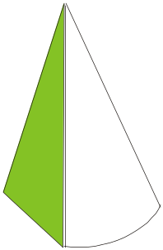


Typical Section Planes
&
Typical Shapes
Of
Sections.
Triangle
Section Plane
Through Generators
Ellipse
Section Plane
Through Apex
Parabola
Section Plane Parallel
to end generator.
Section Plane
Parallel to Axis.
Hyperbola
Ellipse
Trapezium
Cylinder through
generators.
Sq. Pyramid through
all slant edges

Slide 5
DEVELOPMENT OF SURFACES OF SOLIDS.
MEANING:-
ASSUME OBJECT HOLLOW AND MADE-UP OF THIN SHEET. CUT OPEN IT FROM ONE SIDE AND
UNFOLD THE SHEET COMPLETELY. THEN THE SHAPE OF THAT UNFOLDED SHEET IS CALLED
DEVELOPMENT OF LATERLAL SUEFACES OF THAT OBJECT OR SOLID.
LATERLAL SURFACE IS THE SURFACE EXCLUDING SOLID’S TOP & BASE.
ENGINEERING APLICATION:
THERE ARE SO MANY PRODUCTS OR OBJECTS WHICH ARE DIFFICULT TO MANUFACTURE BY
CONVENTIONAL MANUFACTURING PROCESSES, BECAUSE OF THEIR SHAPES AND SIZES.
THOSE ARE FABRICATED IN SHEET METAL INDUSTRY BY USING
DEVELOPMENT TECHNIQUE. THERE IS A VAST RANGE OF SUCH OBJECTS.
EXAMPLES:-
Boiler Shells & chimneys, Pressure Vessels, Shovels, Trays, Boxes & Cartons, Feeding Hoppers,
Large Pipe sections, Body & Parts of automotives, Ships, Aeroplanes and many more.
WHAT IS
OUR OBJECTIVE
IN THIS TOPIC ?
To learn methods of development of surfaces of
different solids, their sections and frustums.
But before going ahead,
note following
Important points.
1. Development is different drawing than PROJECTIONS.
2. It is a shape showing AREA, means it’s a 2-D plain drawing.
3. Hence all dimensions of it must be TRUE dimensions.
4. As it is representing shape of an un-folded sheet, no edges can remain hidden
And hence DOTTED LINES are never shown on development.
Study illustrations given on next page carefully.

Slide 6
Q 14.11: A square pyramid, base 40 mm side and axis 65 mm long, has its base on the HP and all the edges of the base equally inclined to the VP. It is cut by a section plane, perpendicular to the VP, inclined at 45º to the HP and bisecting the axis. Draw its sectional top view, sectional side view and true shape of the section.
2₁
3₁
X₁
o”
o’
4₁
3”
3’
1₁
4”
2”
2’
4’
1’
X
b’
d’
1”
Y
a’
45º
c’
c”
d
d”
a”
b”
4
a
1
o
c
3
2
b
Y₁

Slide 7
Q 14.24: A Cone base 75 mm diameter and axis 80 mm long is resting on its base on H.P. It is cut by a section plane perpendicular to the V.P., inclined at 45º to the H.P. (AIP) and cutting the axis at a point 35 mm from the apex. Draw the front view, sectional top view, sectional side view and true shape of the section.
X₁
e₁
f₁
g₁
c₁
d₁
h₁
i₁
o’
o”
b₁
j₁
k₁
35
g”
g’
f”
h”
a₁
f’
e’
i”
l₁
h’
e”
i’
d’
d”
j”
c’
j’
k’
c”
k”
b’
b”
l”
a’
l’
a”
X
2 12
3 11
4 10
5 9
6 8
Y
7
10”
1
4”
5”
6”
7”
8”
9”
3”
2”
1”
12”
11”
4
3
5
2
c
d
6
b
e
o
f
1
a
g
7
h
12
l
j
i
8
k
11
9
Y₁
10

Slide 8
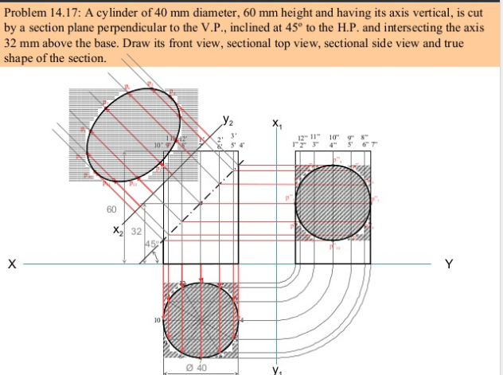

Slide 9
A square prism of 45mm side of base and axis
height 90mm rests with its base on HP such that
one of the rectangular faces is inclined at 30º
to V.P.A section plane Perpendicular to V.P and
inclined at 60º to HP pass through a point on
the axis at height of 70 mm. Draw the Front view
and sectional top view. Also draw the true
shape of the section

Slide 10
J
b’
d’
R,S
c’
a’
T
Z
Q
90
Y1
70
P
60º
D4
D5
S
D3
X
K
Y
T
1’
2’
3’
4’
R
D5
30º
d(4)
D4
D1
T
S
P
D3
D2
a(1)
D2
c(3)
Q
R
D1
X1
40
P
b(2)
Q

Slide 11
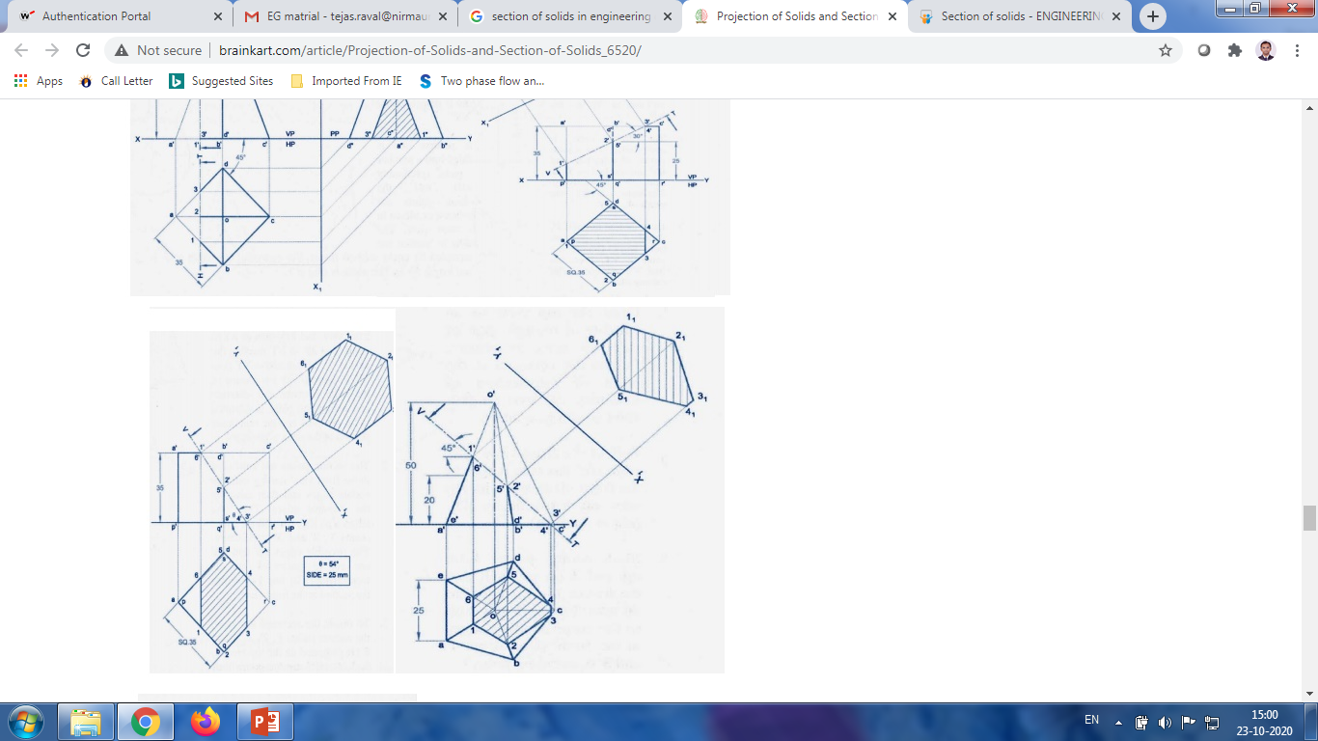
A Cube of having 35 mm sides and 35 mm height is resting on its base on HP such like that its vertical faces are equally inclined to the VP. It is cut by AIP such like that its true shape is regular hexagon. Draw front view, sectional top view and true shape of the section.

